Slide 1
Introduction to Regression Part C – Linear Models

Slide 3
Lecture Outline
Linear models
Estimate of the regression coefficients
Model evaluation
Interpretation

Slide 4
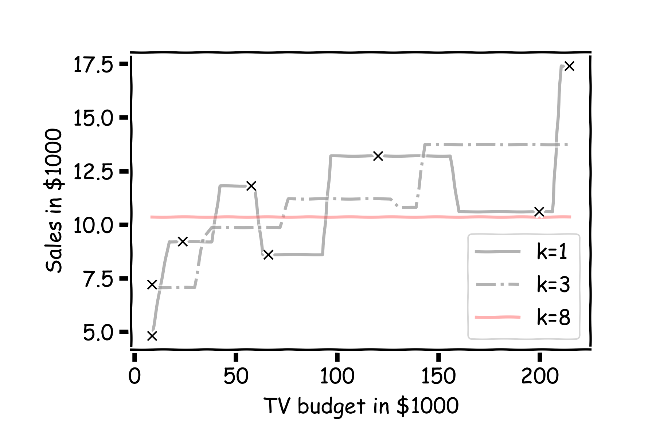
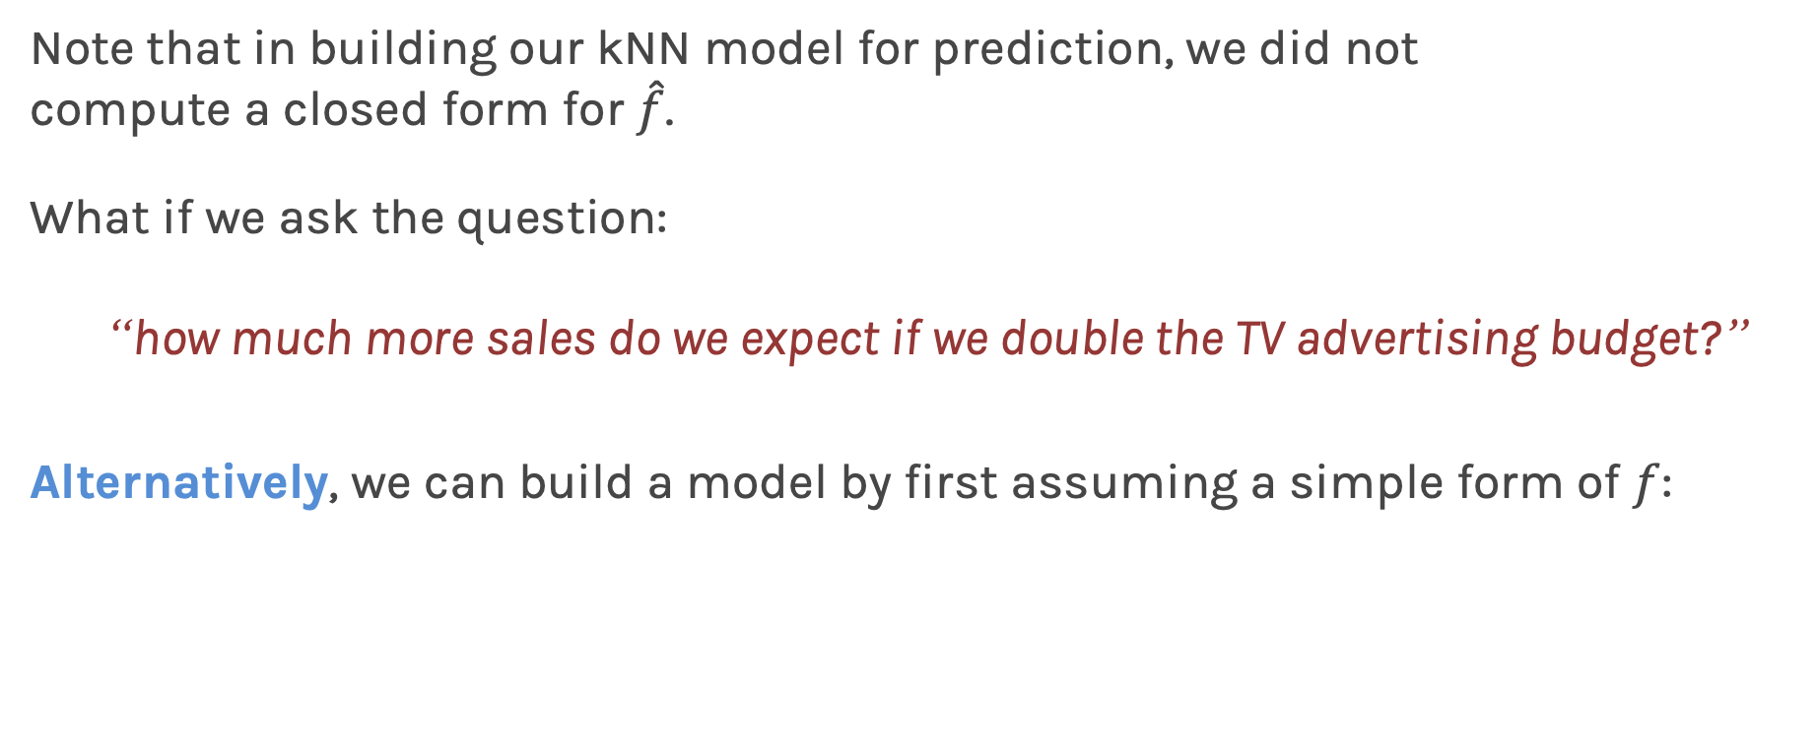
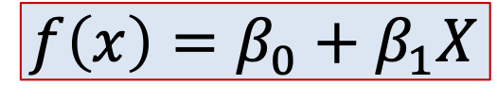
Linear Models
Note that in building our kNN model for prediction, we did not compute a closed form for $\hat{f}$.
What if we ask the question:
“how much more sales do we expect if we double the TV advertising budget?”
Alternatively, we can build a model by first assuming a simple form of $f$:
$$f\left(x\right)=β_{0}+β_{1}X$$

Slide 5
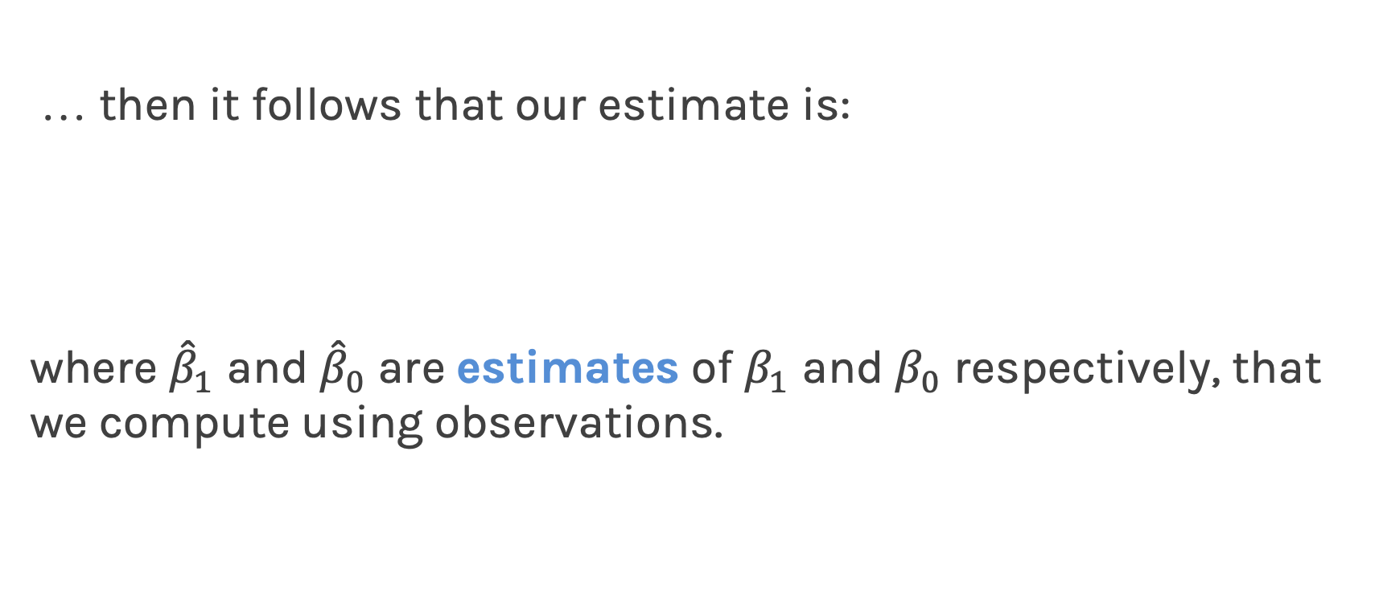
Linear Regression
… then it follows that our estimate is:
where ${\hat{β}}_{1}$ and ${\hat{β}}_{0}$are estimates of $β_{1}$ and $β_{0}$ respectively, that we compute using observations.

Slide 6
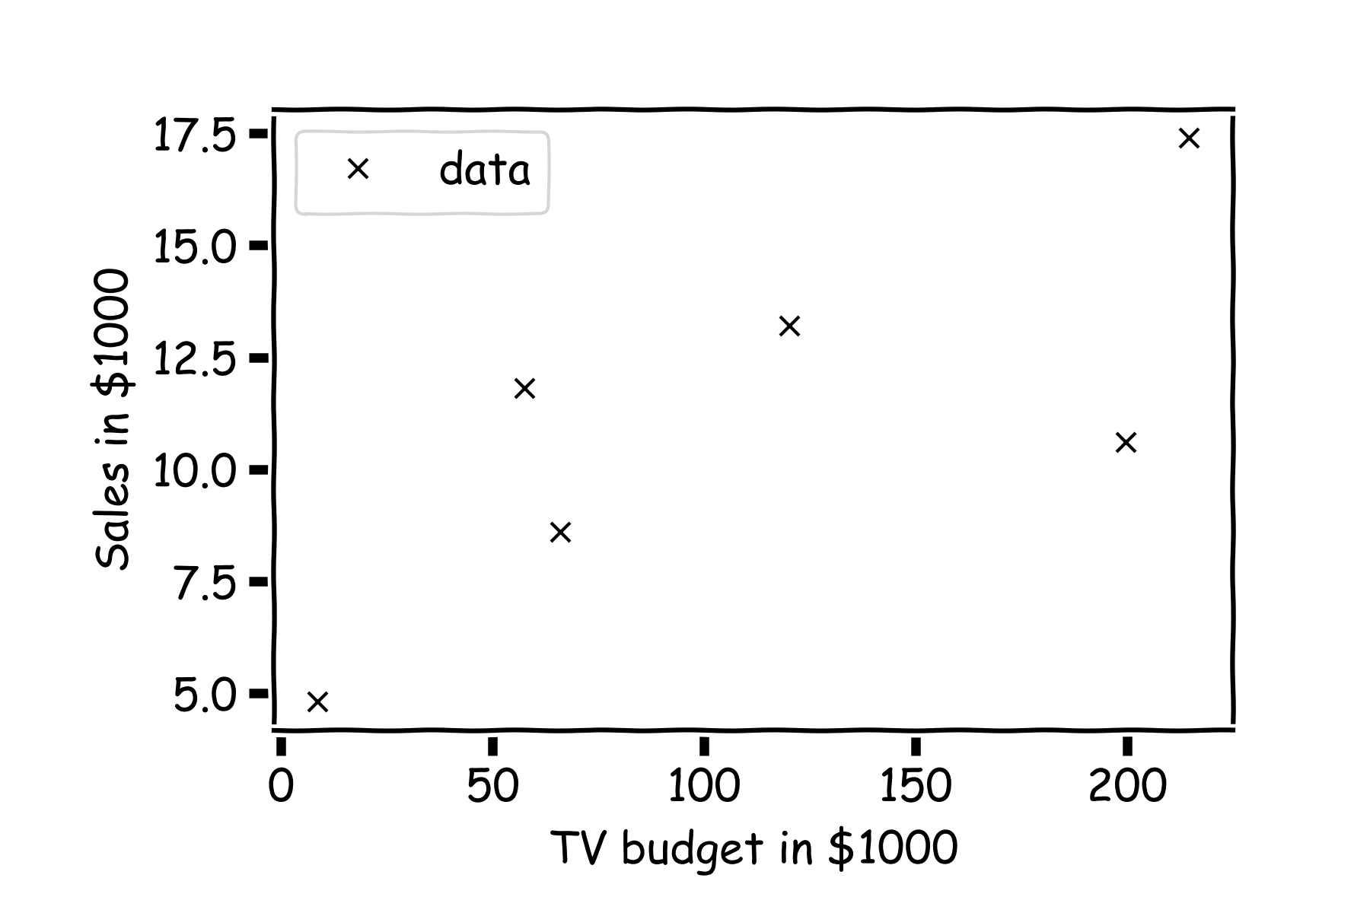
Estimate of the regression coefficients
For a given data set

Slide 7
Estimate of the regression coefficients (cont)
Is this line good?

Slide 8
Estimate of the regression coefficients (cont)
Maybe this one?

Slide 9
Estimate of the regression coefficients (cont)
Or this one?

Slide 10
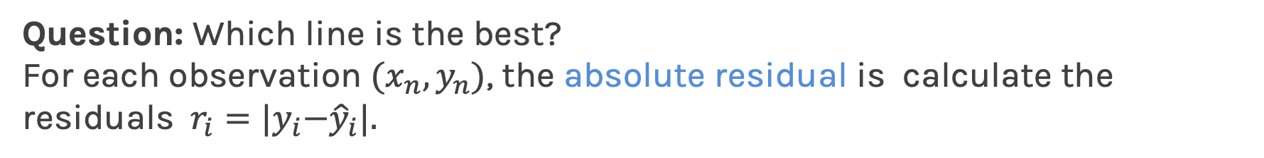
Estimate of the regression coefficients (cont)
Question: Which line is the best?
For each observation $(x_{n},y_{n})$, the absolute residual is calculate the residuals ${ r_{i}=|y}_{i}−{\hat{y}}_{i}|.$

Slide 11
Loss Function: Aggregate Residuals
How do we aggregate residuals across the entire dateset?
Max Absolute Error
Mean Absolute Error
Mean Squared Error

Slide 12
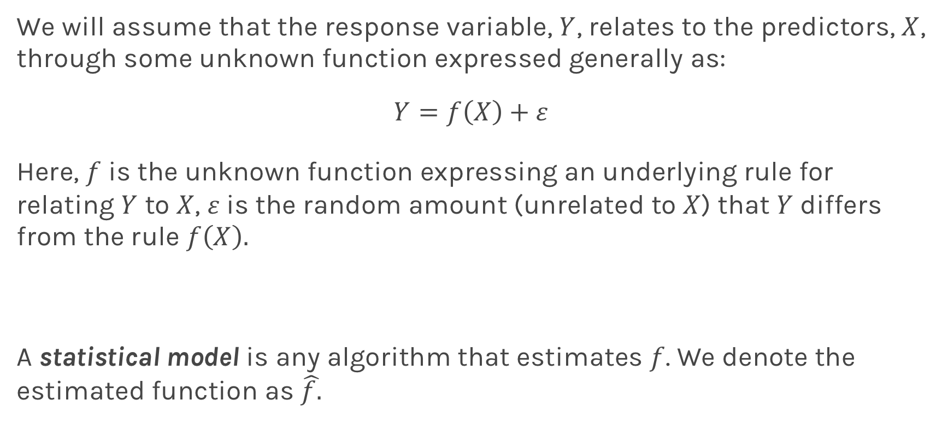
Estimate of the regression coefficients (cont)
Again we use MSE as our loss function,
We choose ${\hat{β}}_{1}$and ${\hat{β}}_{0}$ in order to minimize the predictive errors made by our model, i.e. minimize our loss function.
Then the optimal values for ${\hat{β}}_{0}$ and ${\hat{β}}_{1}$ should be:
WE CALL THIS FITTING OR TRAINING THE MODEL

Slide 13
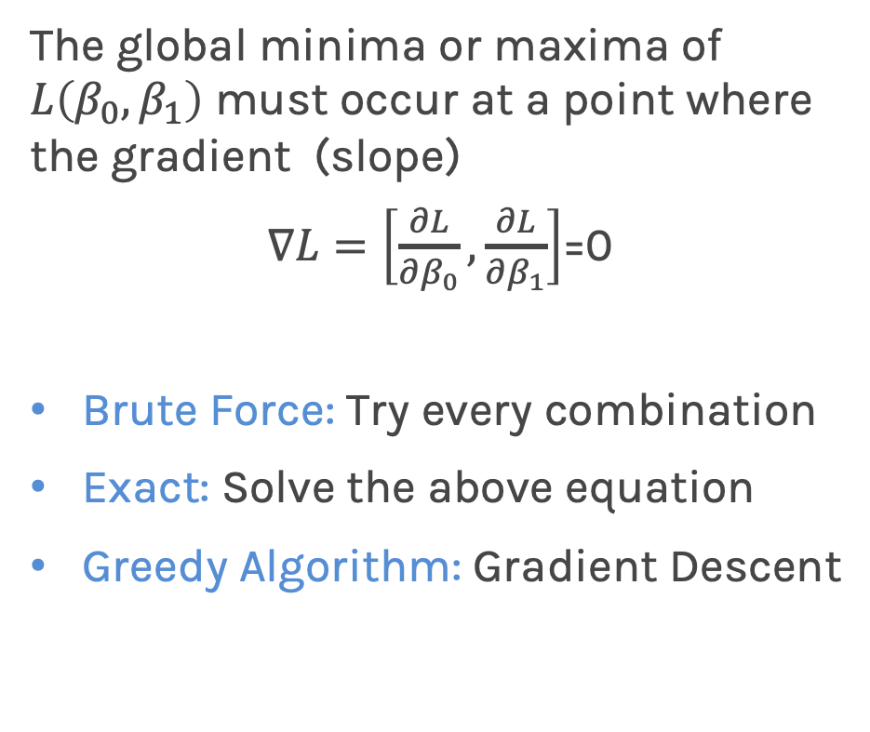
Optimization
How does one minimize a loss function?
The global minima or maxima of $L\left(β_{0},β_{1}\right)$ must occur at a point where the gradient (slope)
$∇L=\left[\frac{∂L}{∂β_{0}},\frac{∂L}{∂β_{1}}\right]$=0
Brute Force: Try every combination
Exact: Solve the above equation
Greedy Algorithm: Gradient Descent
Notes:
Shall I add a contour plot?

Slide 14
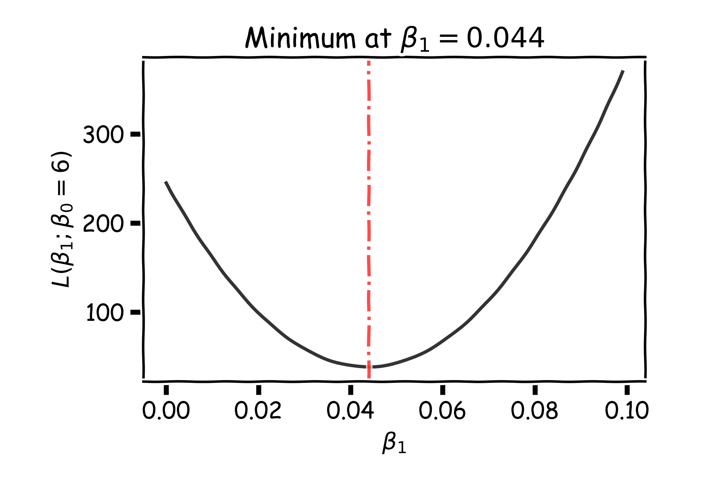
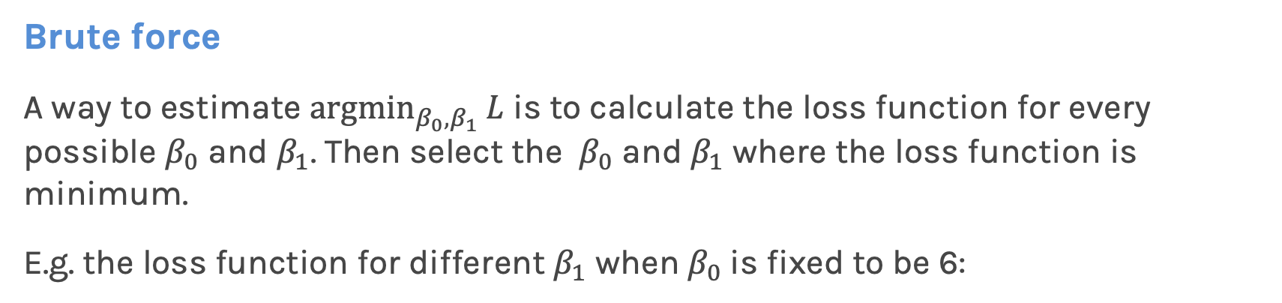
Optimization: Estimate of the regression coefficients
Brute force
A way to estimate ${argmin}_{β_{0},β_{1}}{L}$ is to calculate the loss function for every possible $β_{0}$ and $β_{1}$. Then select the $β_{0}$ and $β_{1}$ where the loss function is minimum.
E.g. the loss function for different $β_{1}$ when $β_{0}$is fixed to be 6:
Very computationally expensive with many coefficients
Notes:
Shall I add a contour plot?

Slide 15
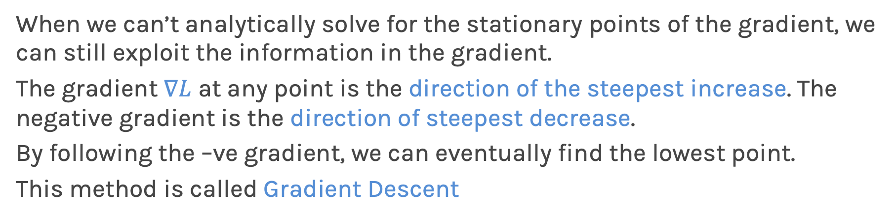
Gradient Descent
When we can’t analytically solve for the stationary points of the gradient, we can still exploit the information in the gradient.
The gradient $∇L$ at any point is the direction of the steepest increase. The negative gradient is the direction of steepest decrease.
By following the –ve gradient, we can eventually find the lowest point.
This method is called Gradient Descent

Slide 16
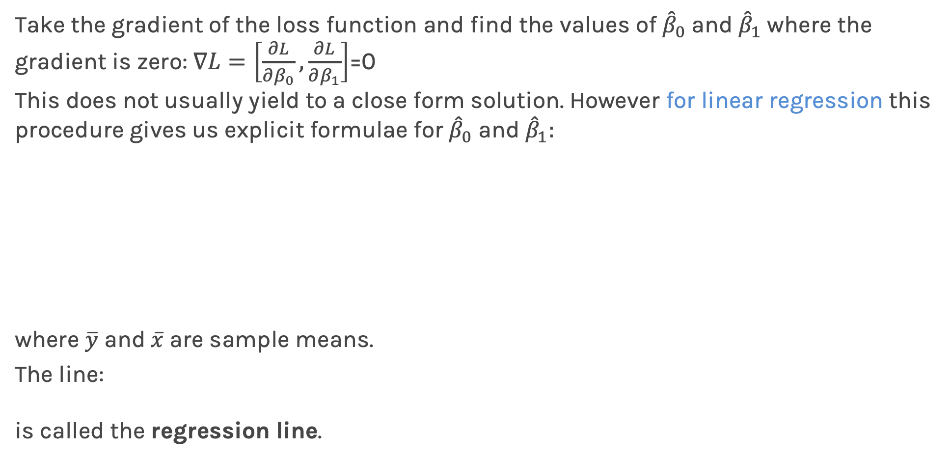
Estimate of the regression coefficients: analytical solution
Take the gradient of the loss function and find the values of ${\hat{β}}_{0}$ and ${\hat{β}}_{1}$ where the gradient is zero: $∇L=\left[\frac{∂L}{∂β_{0}},\frac{∂L}{∂β_{1}}\right]$=0
This does not usually yield to a close form solution. However for linear regression this procedure gives us explicit formulae for ${\hat{β}}_{0}$ and ${\hat{β}}_{1}:$
where $\overline{y}$ and $\overline{x}$are sample means.
The line:
is called the regression line.

Slide 17
Evaluation: Training Error
Just because we found the model that minimizes the squared error it doesn’t mean that it’s a good model. We investigate the R2 but also:
The MSE is high in all four models but the models are not equal.
The MSE is high due to noise in the data.

Slide 18
Evaluation: Test Error
We need to evaluate the fitted model on new data, data that the model did not train on, the test data.
The training MSE here is 2.0 where the test MSE is 12.3.
The training data contains a strange point – an outlier – which confuses the model.
Fitting to meaningless patterns in the training is called overfitting.

Slide 19
Evaluation: Model Interpretation
For linear models it’s important to interpret the parameters
The MSE of this model is very small. But the slope is -0.05. That means the larger the budget the less the sales.
The MSE is very small but the intercept is -0.5 which means that for very small budget we will have negative sales.

Slide 20
Ex C.1, C.2, [C.3]

